Slide 1
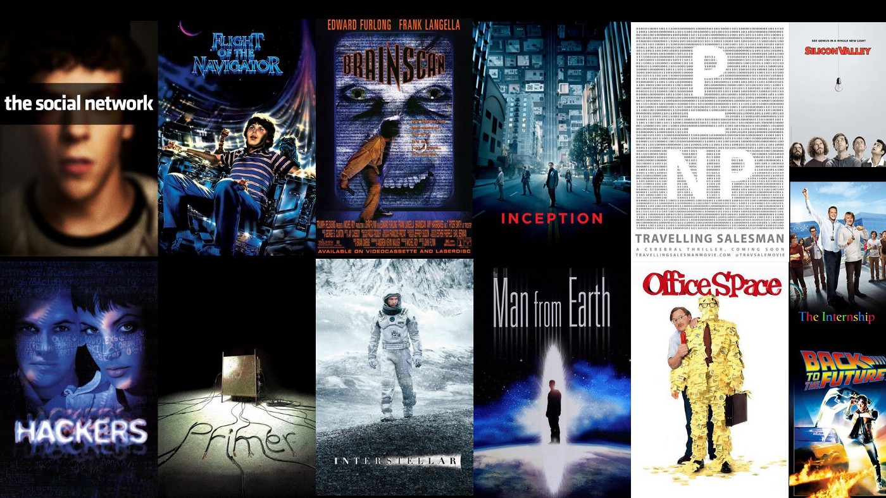

Movie Recommendation System
Marketing Analytics Project:
Building a recommendation system on “The Movies Dataset” from Kaggle
Group F : Priyanka Choudhary, Rehankhan Daya, Shruti Kapur
November 2020

Slide 2





Problem Statement
Simulating customer demand through enhanced engagement & visibility
Recommendation systems are used by almost all the major technology giants today for suggestions on similar products or content.
The ultimate aim of a recommender system is to stimulate customer demand through greater user engagement and increased catalog visibility.
Assume we are marketing consultants for MDB and GroupLens - we have been hired to create a recommendation system to improve user engagement with their service.
In the next segment we compare the various filtering methods - demographic, content based and collaborative. We then build a collaborative filtering based recommender using different approaches.

Slide 3
The Data
Kaggle Movie Dataset
movies_metadata.csv: 45,000 movies featuring posters, backdrops, budget, revenue, release dates, languages, production countries and companies
keywords.csv: Movie plot keywords for our MovieLens movies.
credits.csv: Cast and Crew Information
links.csv: TMDB and IMDB IDs of movies featured in the Full MovieLens dataset.
links_small.csv: TMDB and IMDB IDs of a small subset of 9,000 movies of the Full Dataset.
ratings_small.csv: Subset of 100,000 ratings from 700 users on 9,000 movies.
test.csv and train.csv: Contained data on the budget and revenue of each movie
https://www.kaggle.com/tmdb/tmdb-movie-metadata
https://www.kaggle.com/sjj118/movie-visualization-recommendation-prediction/
https://www.kaggle.com/c/tmdb-box-office-prediction/data?select=test.csv https://www.kaggle.com/rounakbanik/the-movies-dataset
Full data set can be found here https://grouplens.org/datasets/movielens/latest/

Slide 4
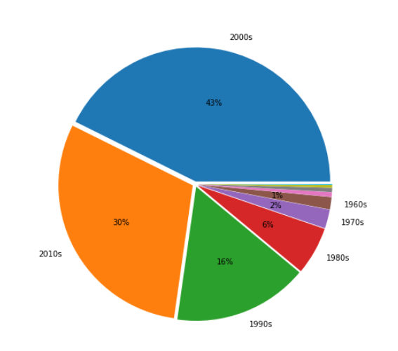
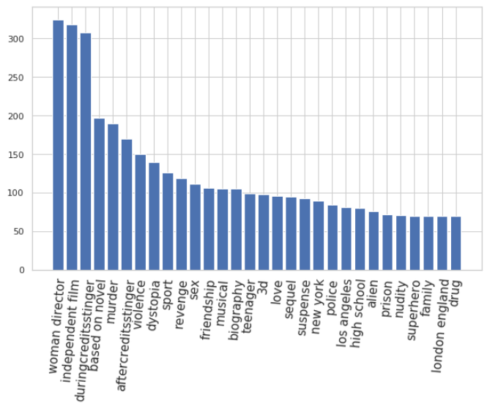
The Data
Kaggle Movie Dataset
Weighted movie count by year
Count of plot keywords

Slide 5
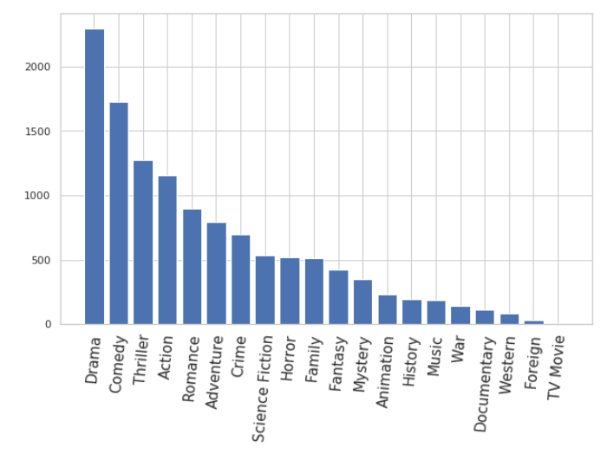
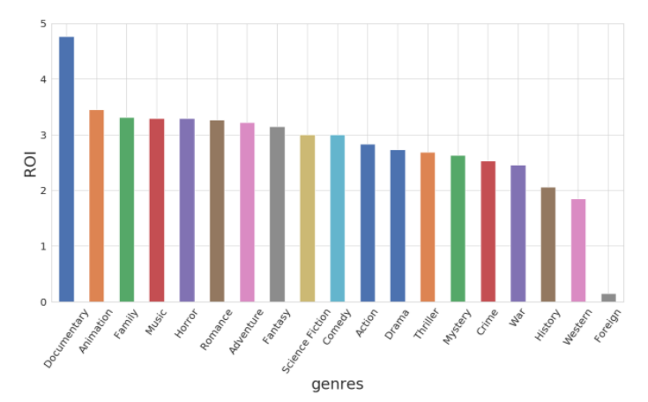
The Data
Kaggle Movie Dataset
Count of genre
ROI by genre

Slide 6
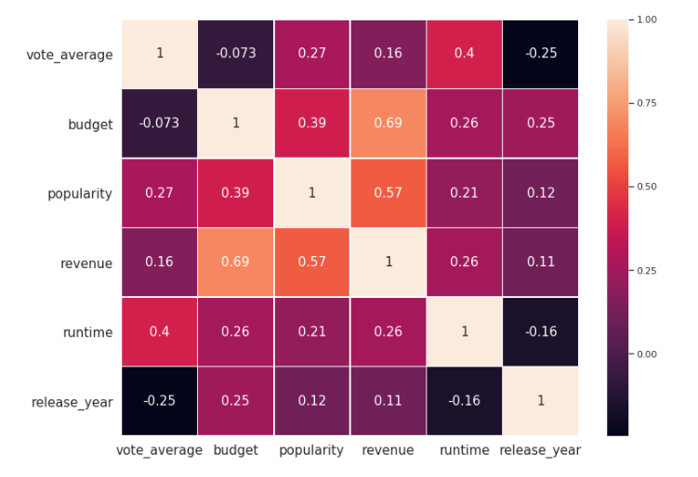
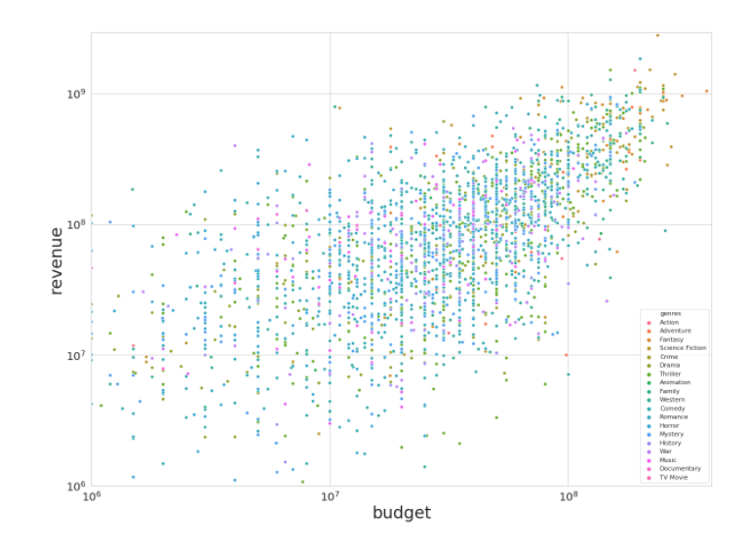
The Data
Kaggle Movie Dataset
Correlation Matrix of numeric variables
Scatter plot of strong correlation

Slide 7
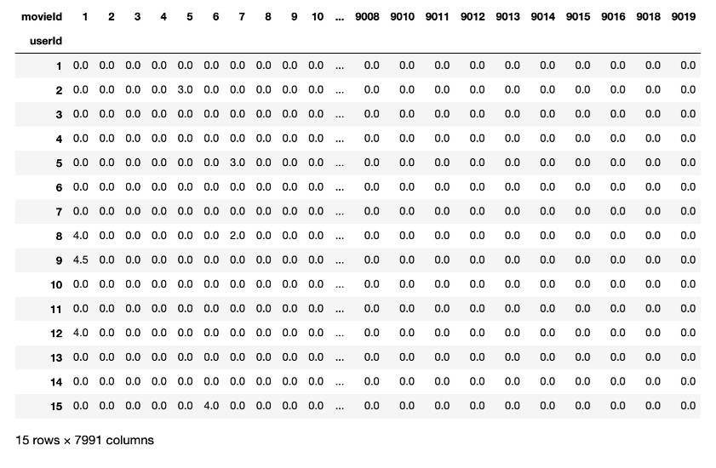
Cold Start Problem?
Kaggle Movie Dataset
df = pd.read_csv('ratings.csv')
df = df[df['userId'] < 10000]
df = df[df['movieId'] < 10000]
df = df.sort_values(by=['movieId'])
mat = df.pivot_table(values='rating', index='userId', columns='movieId').fillna(0)
Reading the first 15 rows of mat gives us this result
mat.shape = 9955*7991

Slide 8
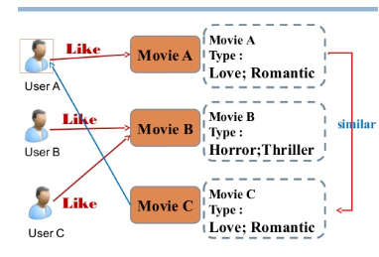
Filtering Methods
Different techniques to building a recommender system
Demographic
uses information about users (age, gender, location)
Content Based
uses information about the movies(metadata about actors, directors, year of release, budget)
Collaborative
uses information from other similar users and their browsing history

Slide 9
Collaborative Filtering
Predicting user ratings with different approaches
Collaborative filtering involves generating or predicting recommendations for a user, A, using information on interests of similar users
User Based
In user based filtering, we try to find similar users with a cosine similarity approach, assigning a higher weight to k users with more similar interests
We then look at content consumed by those k users, calculate an average user rating weighted by similarity of users to user A, and add in ratings for content that has not yet been consumed by user A
Item Based
In item based filtering, we find k most similar items to content already consumed by user A
For each such similar item, we calculate average content rating for user A and add in ratings based on weighted similarity scores of that content

Slide 10
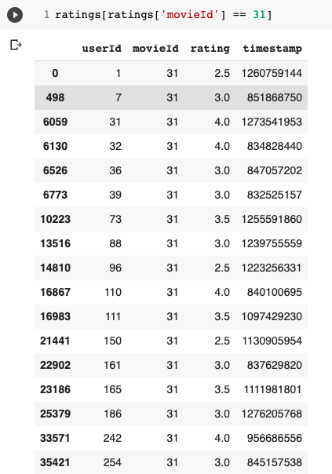
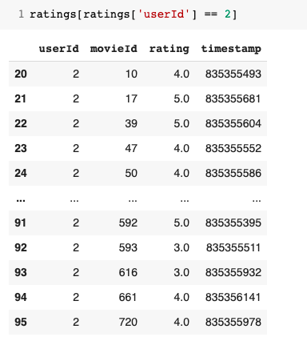
Collaborative Filtering
Implementation on our dataset
To run it on our dataset, we tried predicting scores for User ID = 2
We see that the user, for instance, has no rating for movie ID = 31
We could calculate rating with a user based or an item based approach
However, with a user based approach we run into a sparsity problem because similar users may not have rated movie ID = 31
We would run into the same problem with item based approach for a user who has no history of content

Slide 11
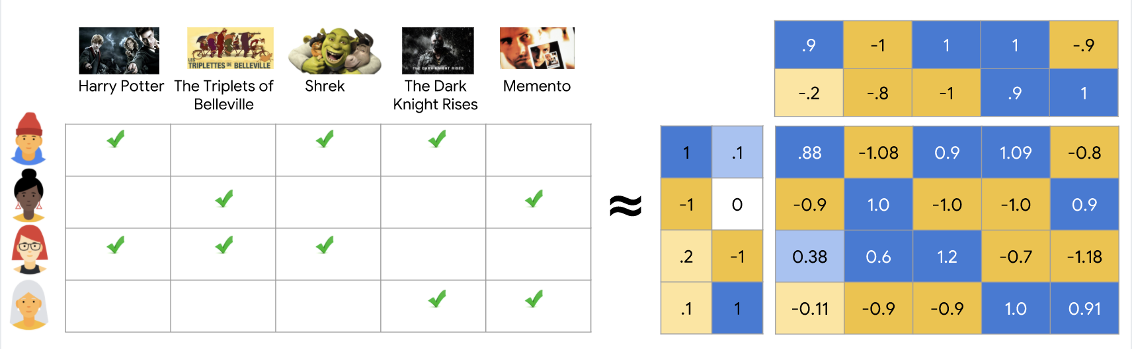
Matrix Factorisation
Tackling the sparsity problem
Matrix factorization is a way to factorise a matrix and generate latent features while multiplying two entities.
Using matrix factorization for collaborative filtering, we will identify the relationship between items’ and users’ entities.
With the input of users’ ratings, we predict ratings of movies not watched by them and give our recommendation based on the prediction.

Slide 12
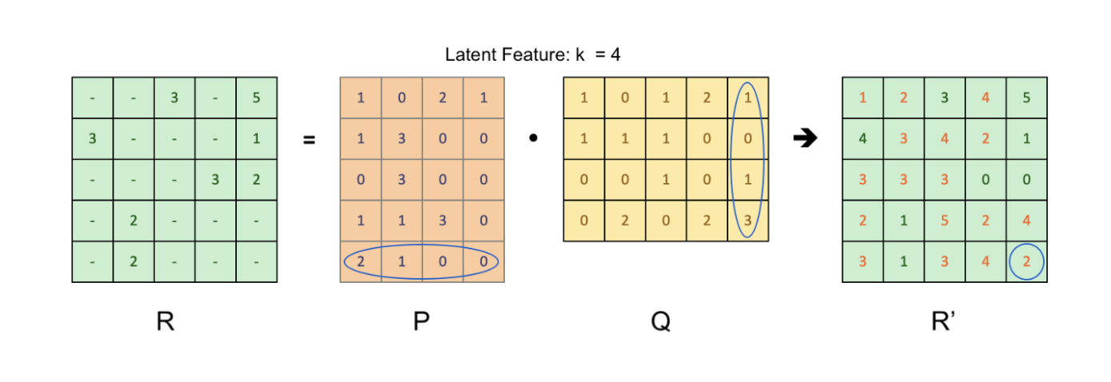
Matrix Factorisation
Tackling the sparsity problem
Ratings of movies watched by all users can be represented as a matrix.
Each row represents a user while each column represents a movie
An instant observation is that the matrix is sparse as all the movies have not been watched by all users
Drawing much intuition from SVD, matrix factorisation is an efficient way to break a matrix into two matrices
The goal is to optimise the cost function which is given by the SSE where the error is R - R’. We can also add a regulariser to the cost function.

Slide 13
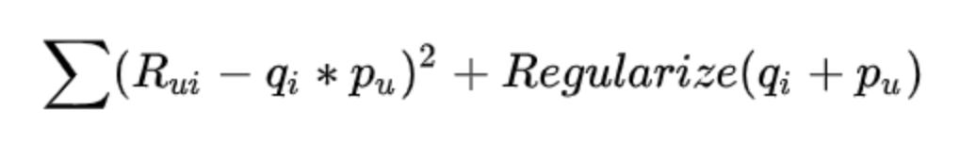
The Process
Implementation on our dataset
Step 1: Create the matrix of users and movies using ratings.csv file (we used the pivot function)
Step 2: Define the number of latent features (similar to topic modelling)
Step 3: Define a matrix factorisation function that will run for an input matrix generated in Step1 and give us two matrices P & Q whose dot product gives us our output matrix R’ . Optimise the cost function to attain minimum error. We have used a scikit learn package for the same.
Step 4: Once we have the final matrix R’, we use it to recommend new movies to the user. For the movies not watched by the user, we recommend the movies with top 5 ratings (heuristics)
Step 5: The generated matrices can now also be used to run user based and item based collaborative filtering recommendation systems

Slide 14
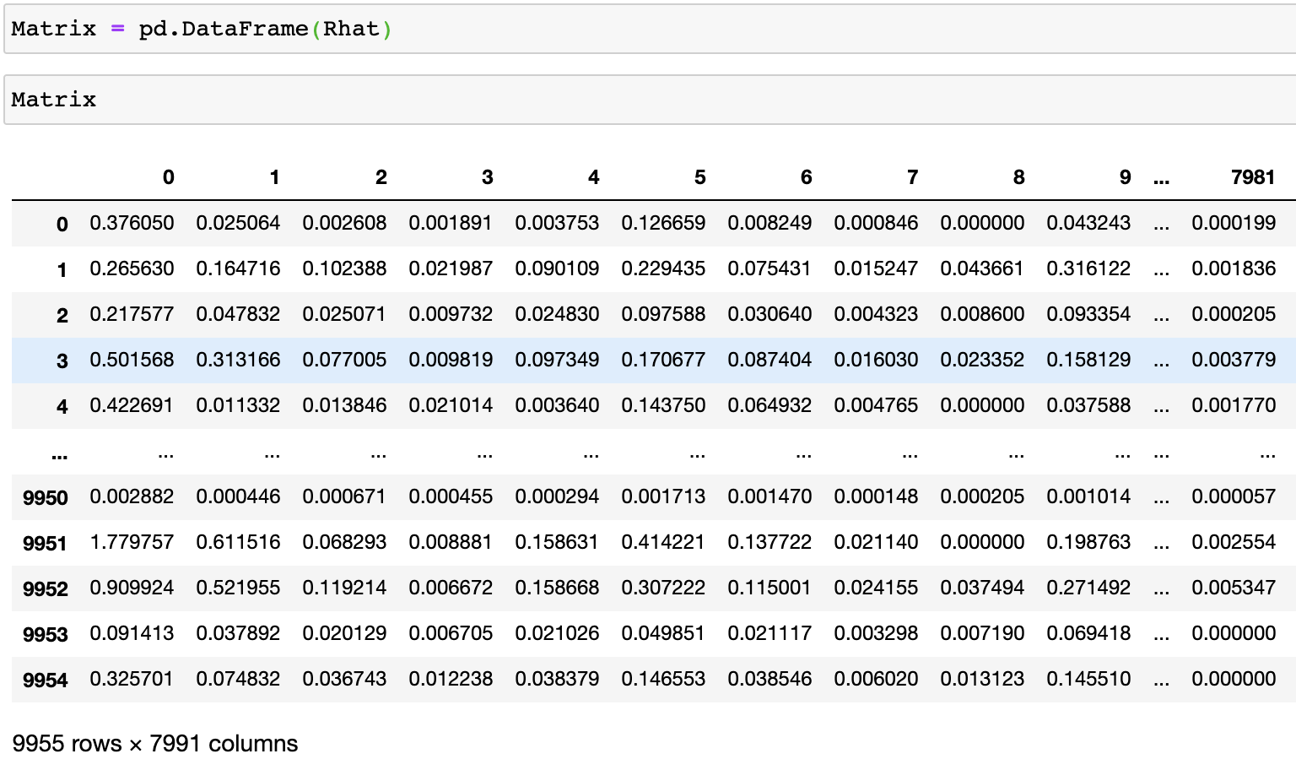
Resulting Matrix
Implementation on our dataset

Slide 15
Importance of Latent Features
Take account of similar movies even when a user has not watched and rated them.
Example : If a user gave good ratings to movie Avengers, Wonder-woman and Captain Marvel, it shows an underlying pattern that this user might be interested in Action movies. Regardless of him/her having watched them, we believe that this user will like Action movies in the future. Unlike individual movies, latent features are expressed by higher-level attributes, and Action category is one of latent features in this case.
Our Understanding: To get a rating we need to take the dot product of row of P and column of Q. Each row of P tells us the user vector of the latent feature, while each column of Q tells us the movie vector corresponding to the latent features. When the user preference and the movie attribute match, a high rating will be observed.

Slide 16
What works and what doesn’t?
Learnings
There are two methods we can be used for cost optimisation - SGD and ALS
Inbuilt functions are also available for matrix factorisation - Scikit Learn, which uses the coordinate descent solver (general form of ALS)
Both L1 and L2 regularizers are also used for cost optimisation in our code
Stochastic Gradient Descent | Alternating Least Squares
Flexible, not reliant on square losses | Reliant on Square losses
Can be parallelized | Can be parallelized
Slow to converge | Converges faster than SGD
Harder to handle unobserved entries | Easier to handle unobserved entries

Slide 17
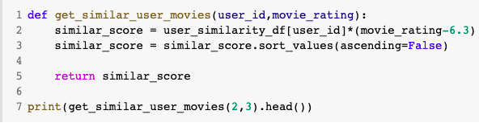
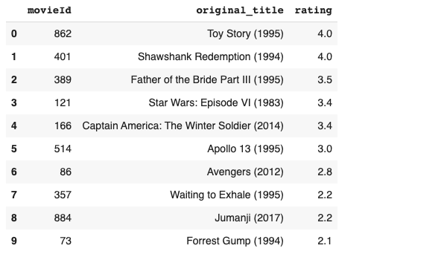
Collaborative Filtering
User based
Once we have the matrix factorization, we can work with our data and compare the collaborative filtering methods with item similarity and user similarity
For user 2, we find similar users
We then compare content that those users have consumed, but user 2 has not yet consumed
We calculate ratings for those movies and recommend the highest rated
We note here that the recommended movies are not similar in content, though they may all be high rated among the similar users

Slide 18
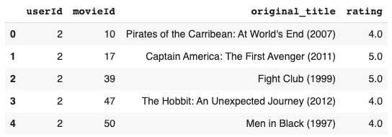
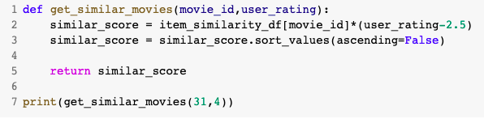
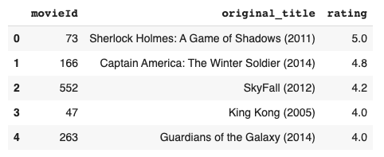
Collaborative Filtering
Item based
For user 2, we see a list of movies that she has already seen
We run cosine similarity with items in the dataset and calculate ratings for the movies that have not yet been seen by user 2
The similarity measure could have been Jaccard or correlation too
We see that item based filtering gives better results than user based filtering

Slide 19
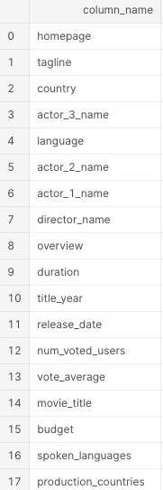
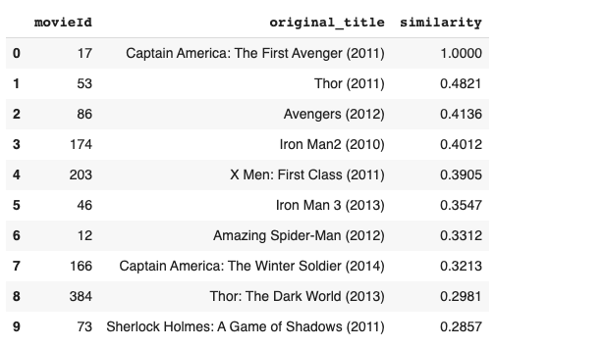
Content based vs Collaborative Filtering
How do they differ
Content based filtering might sound similar to item based collaborative filtering
We ran a content based filtering on the metadata file and got movies similar to ‘Captain America’
It gives closer results than item based collaborative filtering
This is because for movies like ‘Captain America’, the metadata reveals more similarity than the item ratings of a particular user
From this list of similar movies, we can then recommend movies that the user has not yet seen

Slide 20
Takeaways
User Based & Item Based - Collaborative Filtering
USER BASED | ITEM BASED
User based preferences can change over time | Similar item ratings remain stable, can pre compute matrix
Cosine similarity for large number of users is computationally expensive | Cosine similarity over items is relatively easier
Cold start problem faced for new movies* | Cold start problem faced for new genres or dissimilar movies*
*Matrix Factorization solves this
Netflix uses hybrid method: Netflix makes recommendations by understanding and comparing the content consumption habits of similar users, hence implementing collaborative filtering. Additionally, they deploy content-based filtering to recommend movies that are similar to films that a user has rated highly.

Slide 21
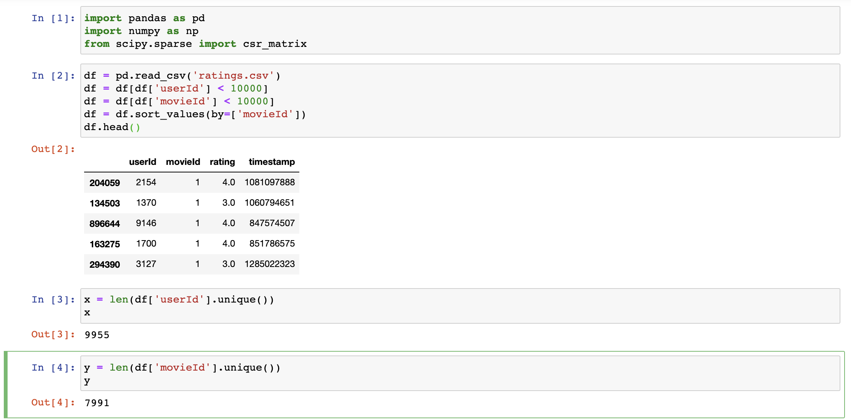
Appendix : Matrix Factorisation Code

Slide 22
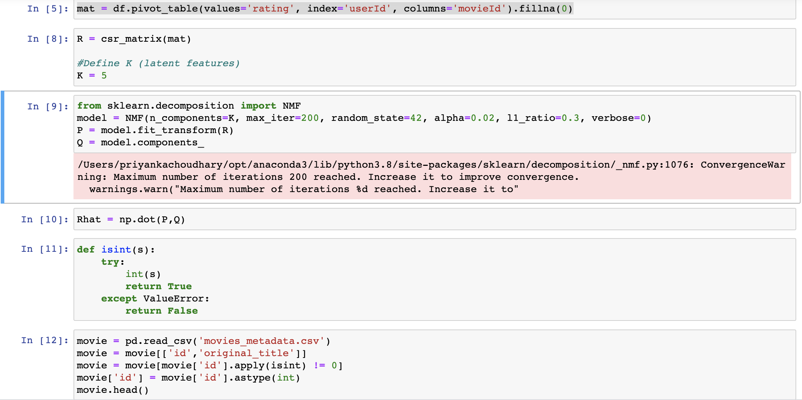
Appendix : Matrix Factorisation Code

Slide 23
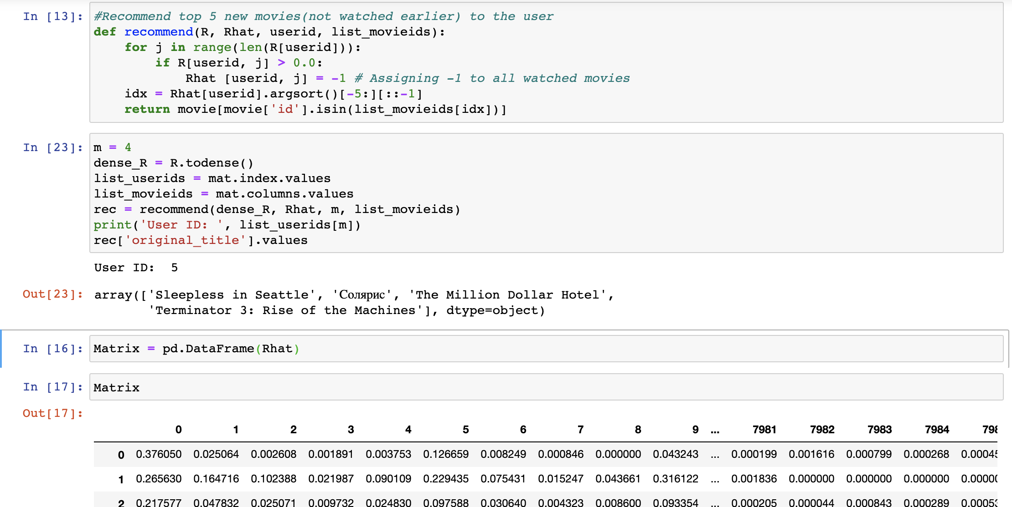
Appendix : Matrix Factorisation Code

Slide 24
Questions

